Slide 1
Orchestra Conductor Simulator
By ECE532 Team 3
Hardik Patel, Parul Seth, Marian Kotormus

Slide 2
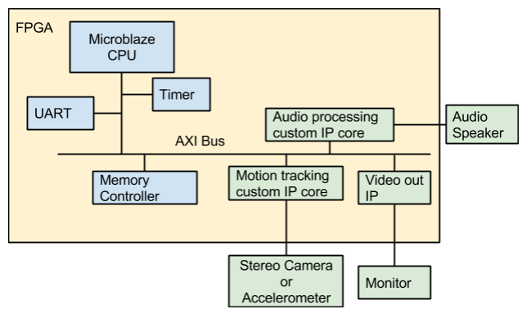
Overall Design Block Diagram

Slide 3
Camera Input + Marker Tracking
OV7670 Capture module
Marker Tracker
RGB color matching + marker location averaging
AXI4 Bus
Camera
Software on Microblaze
TFT Controller

Slide 4
Gesture Recognition
Once the motion tracking module gives out the points collected by it, the gesture recognition algorithm processes them and tries to match it with the existing gestures.
When the gesture matches to any one the pre coded gestures, it signals the song module to change the tempo.
If it does not match any, the already playing tempo continues.

Slide 5
Audio IP
The song ip produces sound by flipping the output bit between 1 and 0 at the frequency of the note required.
•A counter chooses the required note to play and for how long to play.
•IP takes ‘tempo’ as an input from the gesture recognition algorithm.
•Tempo makes the counter run faster or slower as required
LPF
Audio IP
AXI4 Bus
Mono

